Slide 1
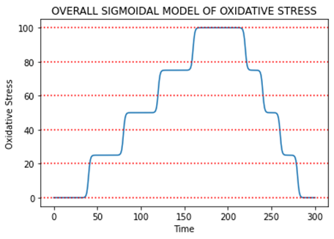
0 5 10 15 20 25 30
(Days)

Slide 2
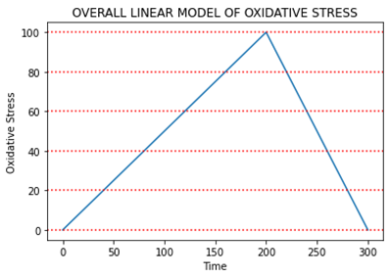
0 5 10 15 20 25 30
(Days)

Slide 3
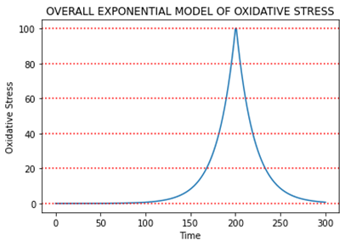
0 5 10 15 20 25 30
(Days)

Slide 4
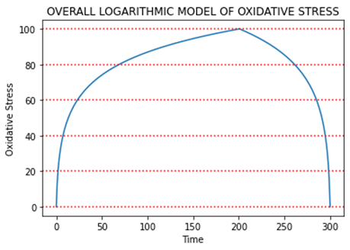
0 5 10 15 20 25 30
(Days)

Slide 5
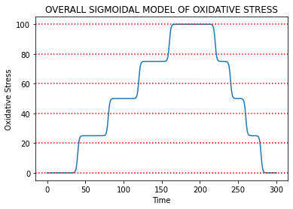
0 5 10 15 20 25 30
(Days)

Slide 6
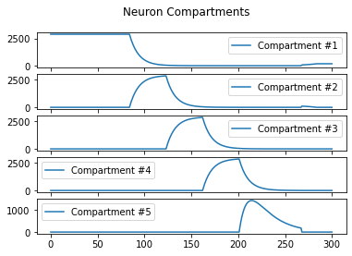
0 5 10 15 20 25 30

Slide 7
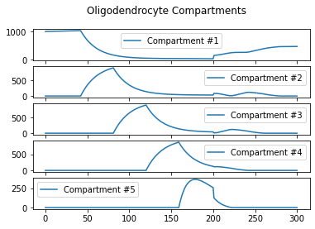
0 5 10 15 20 25 30

Slide 8
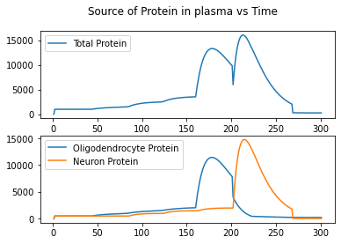
0 5 10 15 20 25 30
0 5 10 15 20 25 30

Slide 9
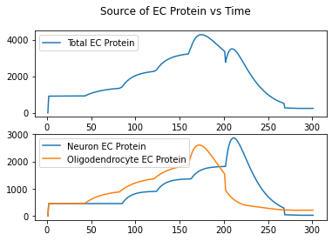
0 5 10 15 20 25 30
0 5 10 15 20 25 30

Slide 10
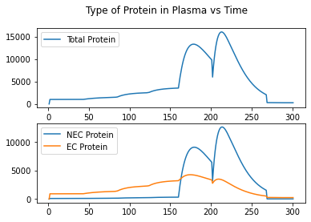
0 5 10 15 20 25 30
0 5 10 15 20 25 30

Slide 11
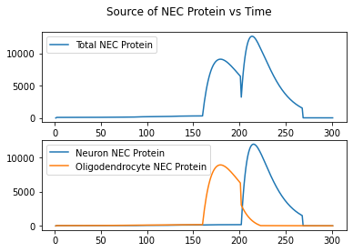
0 5 10 15 20 25 30
0 5 10 15 20 25 30

